Slide 1
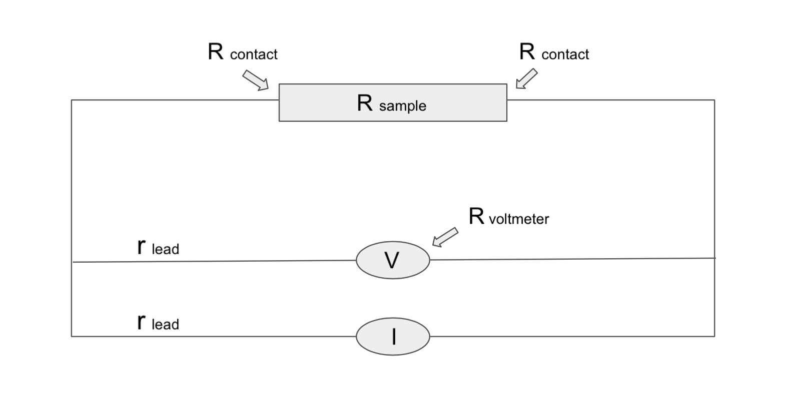
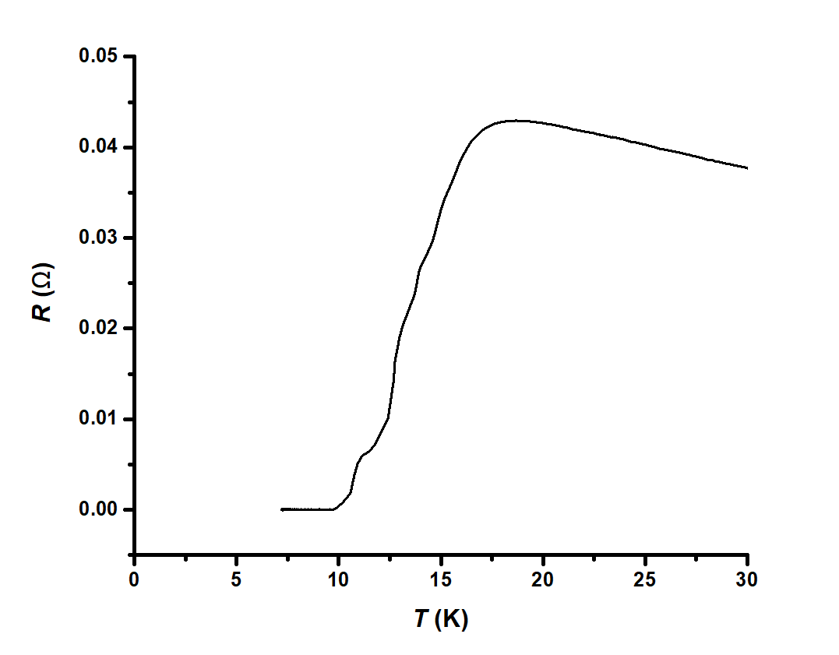
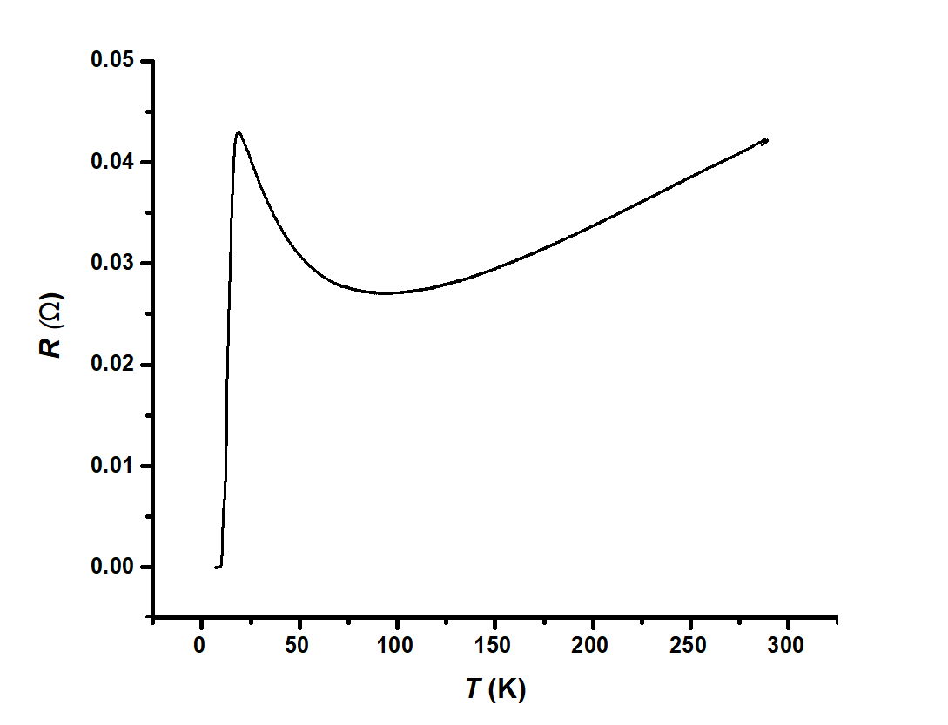
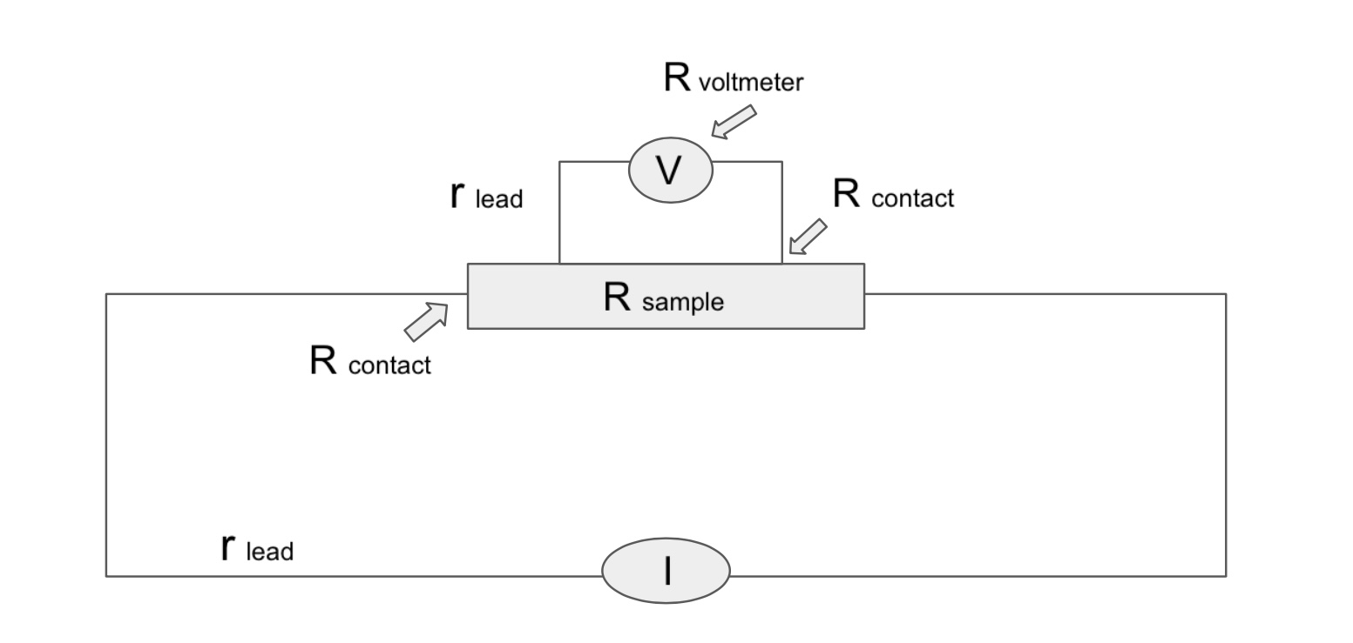
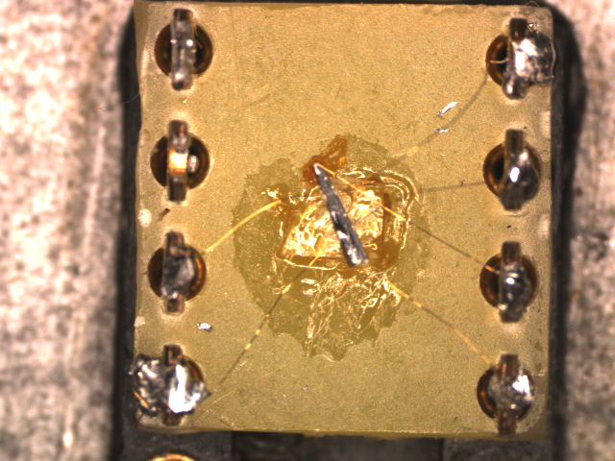
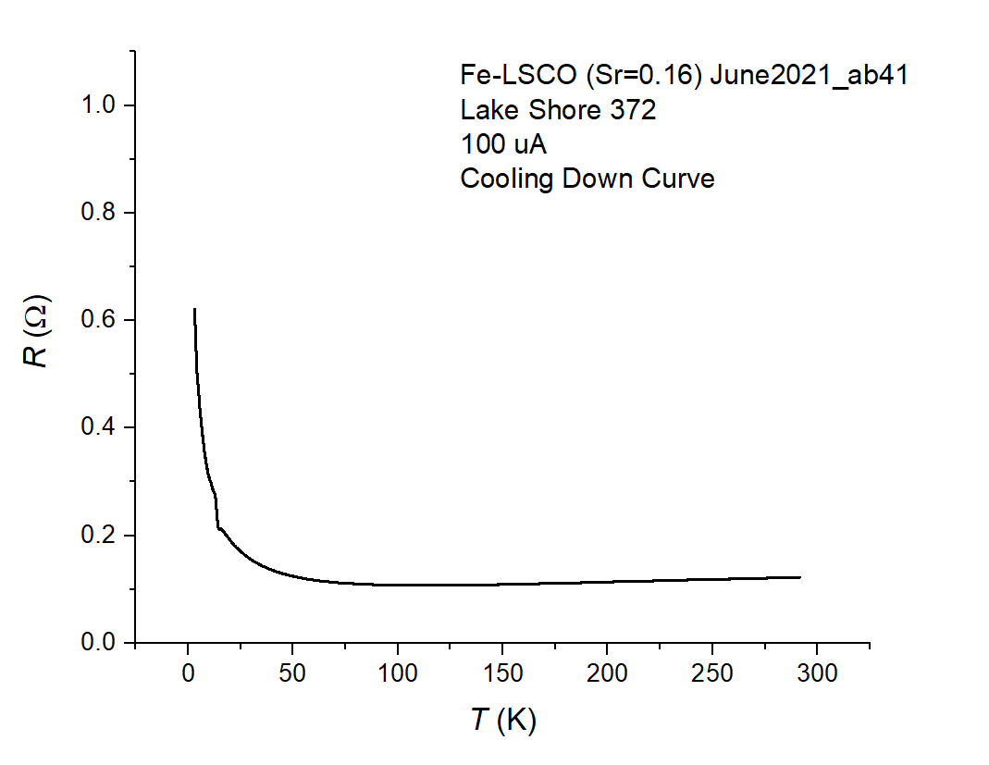
Condensed matter physics is the study of the macroscopic and microscopic physical properties of matter. This project will focus exclusively on the physical properties of materials known as cuprates. Cuprates are superconductors, meaning that under certain conditions, they can conduct electricity with no resistance. The current flow in these materials can create large magnetic fields while producing almost no heat. Cuprates are one of many materials that are considered “high-temperature superconductors” (HTS) [1], meaning they can carry a current with no resistance at a higher temperature than the conventional low-temperature superconductor. In the past, the technological and medical fields only used low-temperature superconductors. Research of high-temperature superconductors has contributed to these fields: HTS have been used in NMR and MRI systems as well as electrical power transmission systems [2]. Through our research, we aim to gain a deeper understanding of these cuprate materials, which are loosely defined as materials containing anionic copper complexes. To test the resistance of our sample, we place it under extremely low temperatures in a cryogenic tank, which can be described as a large thermos with liquid helium or liquid nitrogen inside to keep it cool. The sample is placed in the tank with a probe and its resistance is measured through a resistance bridge. In this specific project, we worked with a ${La}_{2−x}{Sr}_{x}{Cu}_{1−y}{Fe}_{y}O_{4}$sample, where y=0.01 and x=0 (Fe-LSCO).
Testing a Cuprate High Temperature Superconductor
Natalija Nikolić
Dr. Dragana Popović, National High Magnetic Field Laboratory
Condensed Matter Physics
Procedure
Introduction
Results
Two-Probe Measurements
To set up a two-probe resistance measurement system, we connect two probes to the box holding the sample. Connected to one probe are the V+ and I+ contacts, and the other probe is connected to the V- and I- contacts; the probes are connected to the resistance bridge. This method measures the voltage and current together to find the resistance using Ohm’s law: V=IR. In this set-up, V=(I-i)(Rsample+2Rcontact+2rlead)-
- i(2rlead), where I is the current flow through the I+, I- probes, and i is the current flow through the voltage probes. Since Rvoltmeter is much higher than any other resistance in the circuit, the current flow through the voltage probe becomes negligible, and the equation becomes V=I (Rsample+2Rcontact+2rlead) [3]. Rcontact can be found by comparing the results to those from four-probe measurements.
We measured the resistance R of the sample as we gradually lowered its surrounding temperature. Our data showed that the sample’s resistance was on a gradual decrease from around 300 K to 100 K, below which it spiked up. Finally, at around 10 K, the resistance of the sample dropped to zero.
Methods
Preparing the Sample
First, we cut and polished the DIP headers to ensure that they fit the probe. We took pictures with the microscope of the sample and found its dimensions.
Contact Resistance
To check the resistance of the contacts themselves, we did a two-probe resistance measurement at room-temperature using the Lake Shore 372 temperature controller and resistance bridge.
We tested the contact resistance again using a four-probe resistance measurement.
Superconductivity of Sample
To test the superconductivity of the sample, we attached it to a probe and placed it in a cryogenic dewar filled with liquid helium to cool the sample.
We did a four-probe resistance measurement using the Lake Shore 372 temperature controller and resistance bridge.
We diluted Dupont 6838 Silver Paste with Butoxyethyl Acetate.
We attached the voltage and current contacts on the sample with the silver paste solution and annealed it. The annealing process requires an oven of 450°C with an oxygen atmosphere. We place the sample in this environment for 20 minutes and slowly allow to cool down before we connected it to a DIP header with sapphire and GE varnish. This process allows the silver paste to harden and secure the contacts on the sample.
Contacts
Four-Probe Measurements
Discussion
We expected to observe the sample become superconducting due to previous magnetization measurements. After reattaching the voltage contacts on both sides of the sample and running the experiment again, the results supported our hypothesis,. At around 10 K, the sample showed superconductivity as its resistance dropped to zero, suggesting that the critical temperature T_{c} was $\sim$10 K.
Sample Contacts
In a four-probe measurement, each individual contact is connected to its own probe, which is then connected to the breakout box. The breakout box is then connected to the resistance bridge, and the resistance of the sample is measured directly as a function of temperature when the sample is lowered into the dewar. Indeed, in this set-up, V=(I-i)(Rsample)-i(2rcontact+2rlead), but because Rvoltmeter is much larger than any other resistance in the system, i becomes negligible: i<< I [3]. Thus, the equation becomes V=I Rsample.
Conclusion
The primary goal of our research was to affirm that this cuprate material is a superconductor (it can conduct electricity with zero resistance). We plan to prepare the sample for future tests to measure its superconductivity over a range of different magnetic fields. This future research will help expand our current knowledge of cuprate physics.
Limitations
References
Our first attempt at testing the sample was erroneous. This is the cooldown data that was collected from the first trial with the Lake Shore 372 temperature controller and resistance bridge. The sample did not seem to show superconductivity at any point, meaning the resistance did not drop to zero, which was contradictory to our original hypothesis.
[1] B Keimer et al. Nature 518, 179-186 (2015)
[2] Adir, Luiz Moysés (2011). Applications of High-$T_{c}$ Superconductivity. InTech; DOI: 10.5772/36536.
[3] Ekin, J. W. (2006). Experimental techniques for low-temperature measurements: Cryostat design, material
properties, and superconductor critical-current testing. Oxford: Oxford University Press.
We concluded that our results may have been erroneous due to some error in the voltage contacts. Thus, for our second trial, we re-did the voltage contacts and put them on both sides of the sample.
The sample attached to the DIP header and connected to a box, which we use to test the contact resistance at room temperature.
Acknowledgements
I would like to thank Dr. Dragana Popović for entrusting me with this project and expanding my knowledge of condensed matter physics. I am so thankful for this opportunity. I would also like to thank Yuxin Wang and Bal K. Pokharel for their patience and help throughout this process. I am also grateful to UROP for giving me the opportunity to be part of such an amazing team. Thank you.

